Slide 1
Non- Reimbursable Meals
Provided by the LAUSD Food Services Division

Slide 2
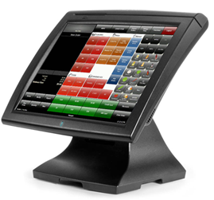
Objective
To understand and define non-reimbursable meals, regulatory mandates, documentation, policies and procedures.

Slide 3
What Is Reimbursement?
Reimbursement is defined as:
Federal and State cash assistance payable to participating schools for meals meeting the requirements and served to eligible children.

Slide 4
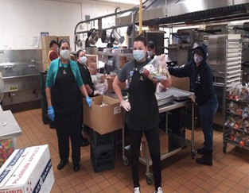
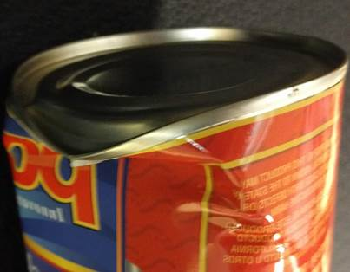
Non-Reimbursable Food Items
When food items are used that do not meet the Federal and State requirements for reimbursement, they are considered non-reimbursable.
Employee meals
Student A La Carte items
Faculty A La Carte items
Adult BIC meal
Other non-reimbursable foods
Theft
Burnt
Damaged

Slide 5
Adult Meal Policies
California Ed. Code 49531
Reimbursable meals are limited to students who meet the criteria under federal regulations
Adult meals are not reimbursable
LAUSD Board Rule 1551
No free food or meals including leftovers will be provided to:
Faculty
Administration
Non-Food Services Staff

Slide 6
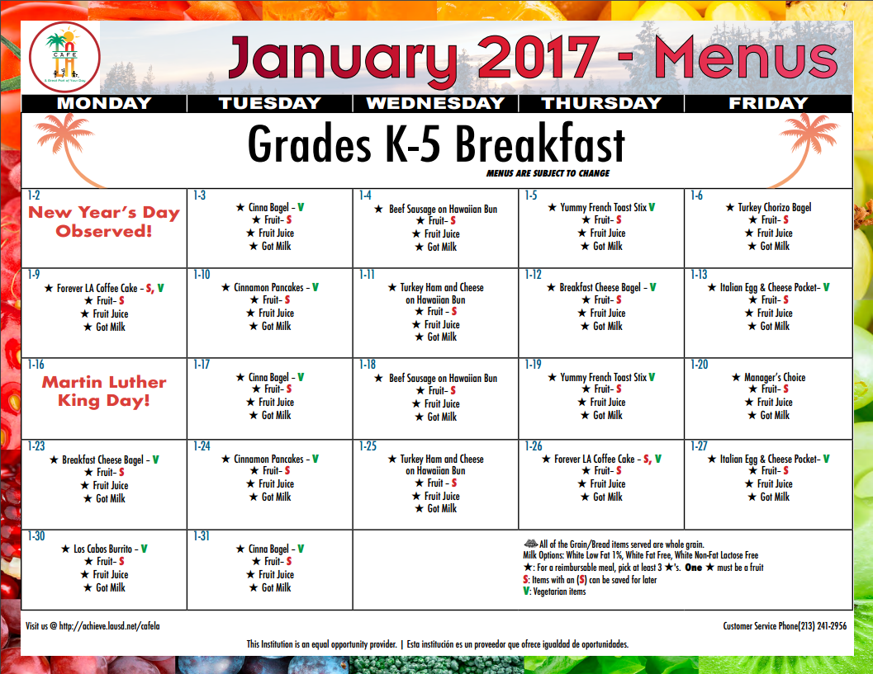
Menus And Recipes
Only approved menus and standardized recipes can be used for meal service.
May not use your own recipe that includes items from:
Cafeteria inventory
Outside the cafeteria

Slide 7
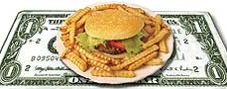
Food Service Employee Meals
Food Service employees are entitled to one meal a day:
Non-reimbursable meal benefit
$4.50 meal allowance
Enter in CMS as employee meal
Instructions are available on Café LA website → Training & Resources → CMS → Cashier Daily Entry Guide

Slide 8
How To Claim Employee Meals
Adult employee meals
Forms
Faculty A La Carte Sales and Inventory
Sales and Cash Reconciliation
Production Worksheet
CMS POS System
CMS POS “Employee-no ID”
CMS Production Record
Non-reimbursable meals
Student A La Carte Sales and Inventory Form
Production Worksheet

Slide 9
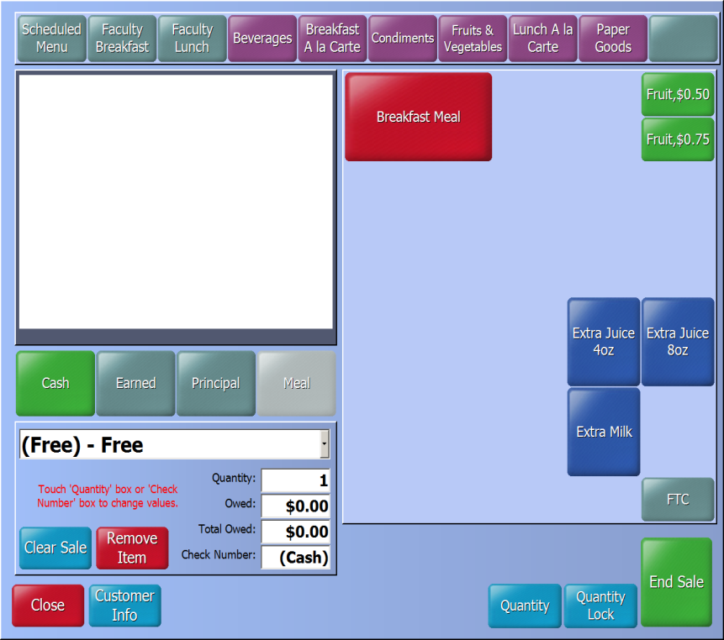
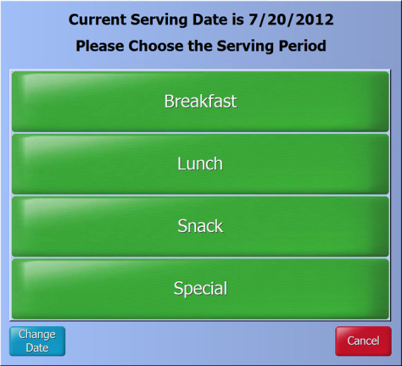
Click on Employee lunch, using the dropdown arrow next to “Menu” choose No ID Employee.
Lunch
Use a CMS POS till that is open for lunch service
Lunch Meal
NO ID Employee

Slide 10
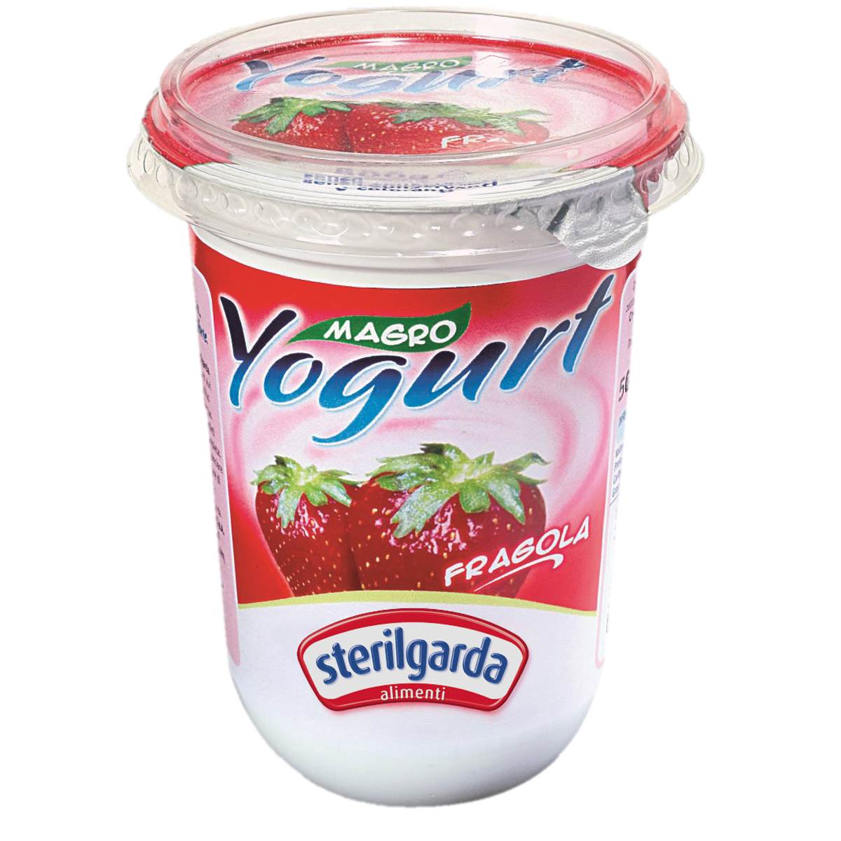
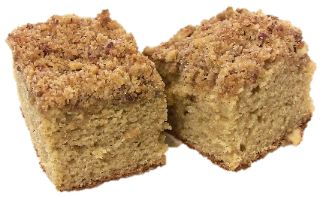
Student & Faculty A La Carte
Students and faculty may purchase single food items at the cost reflected from the A La Carte pricing sheets.

Slide 11
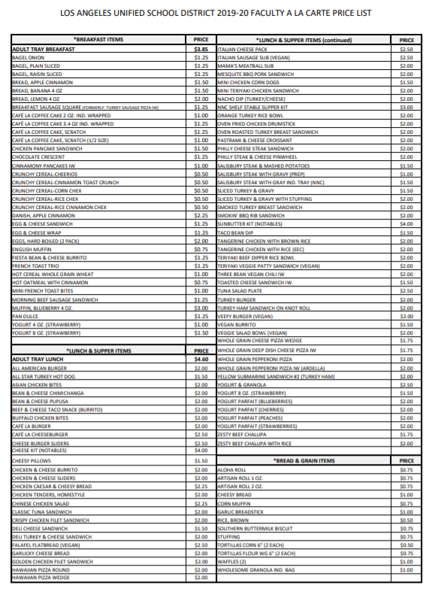
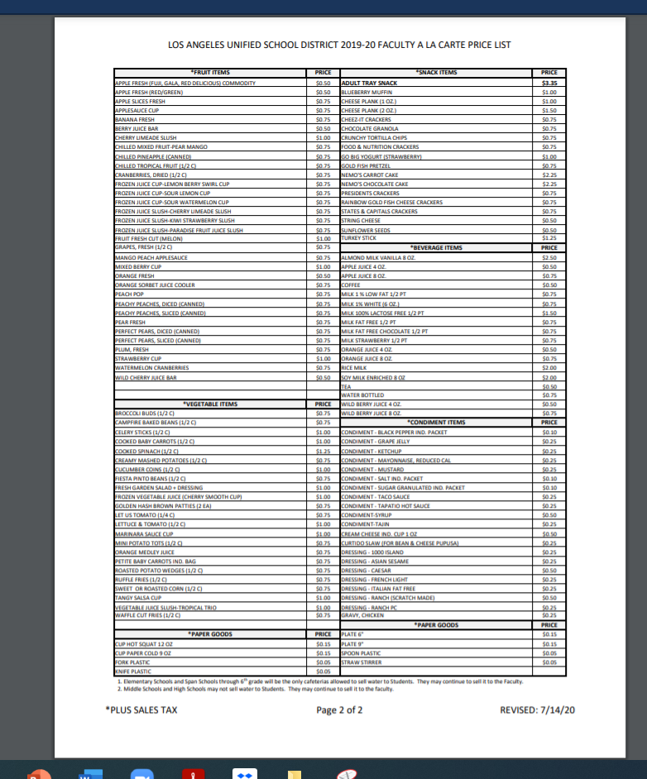
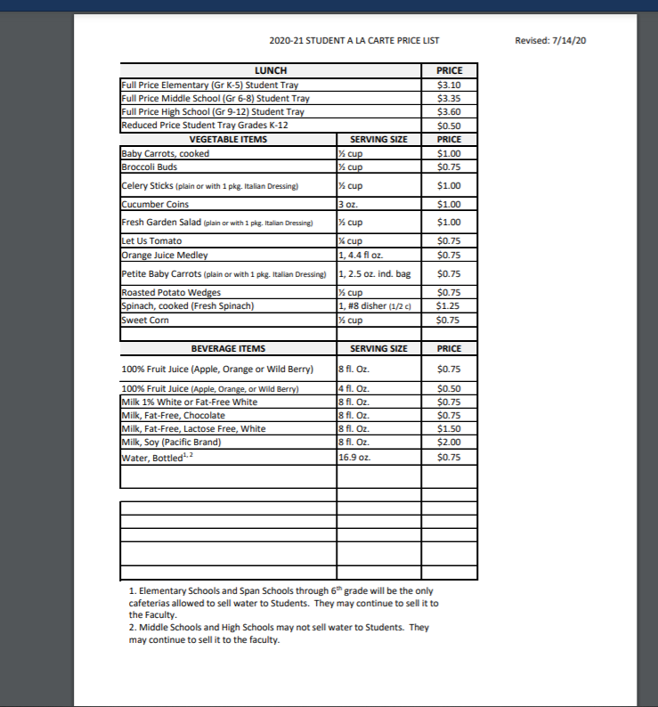
A La Carte Pricing
Café LA website → Menu → Faculty A la Carte Price List
Café LA website → Menu → Student A la Carte Sheet

Slide 12
Faculty and/or Student A La Carte Sales & Inventory Form
Form reflects:
Beginning Inventory
Items Added
Items Deducted
Ending Inventory and Leftovers
This form serves as a check and balance of adult and employee meals served.

Slide 13
How To Claim Student A La Carte Sales
Student A La Carte
From CMS POS
Go to Manual Lookup
Choose the student by last name
Enter the A La Carte food item(s) purchased
Collect cash or apply payment from student account

Slide 14
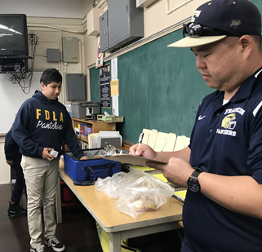
Adult BIC Meals
Adult BIC meals that do not meet Federal and State requirements for reimbursement, are paid by the District through the general fund. These meals are recorded in CMS as an Adult BIC meal.
Teacher
One meal per classroom
Meals received are recorded on the classroom roster
Enter into CMS

Slide 15
How To Claim Adult BIC Meals
Adult BIC meals are tracked by:
Faculty A La Carte Sales and Inventory
Items Deducted (column 3)
Production Worksheet
Non-Reimbursable/A La Carte (column 9)
CMS POS “FACULTY BIC”
CMS Production Record

Slide 16
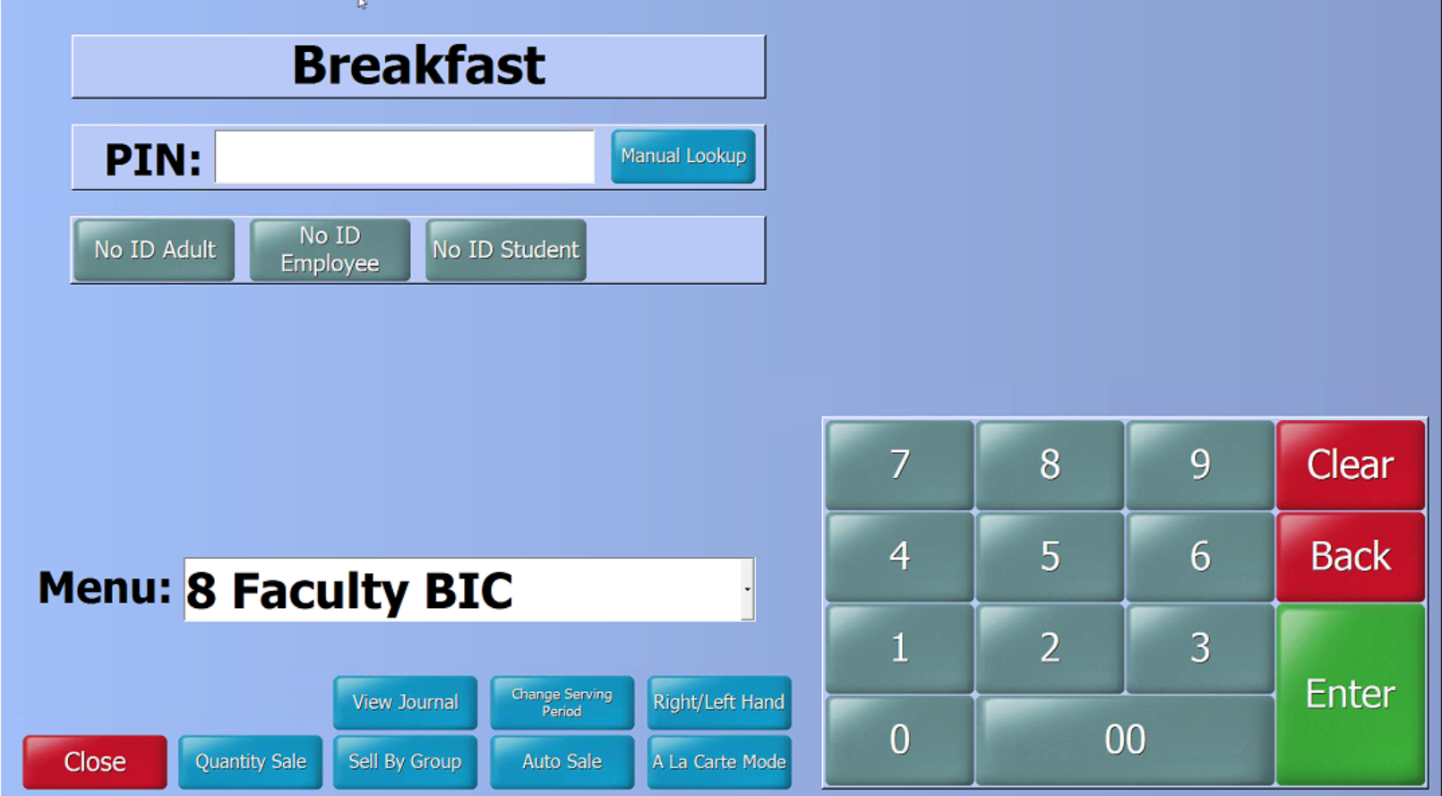
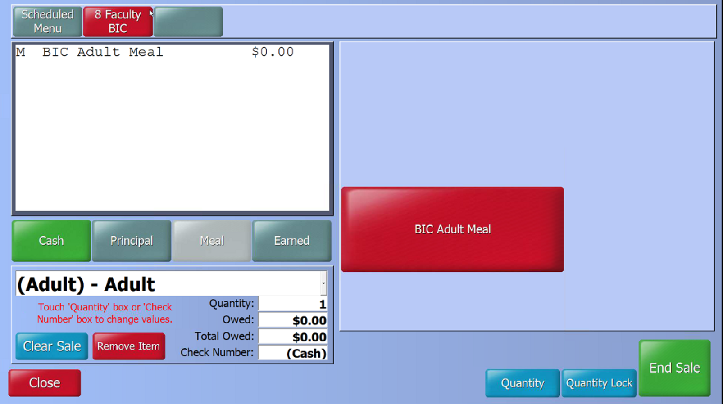
7. Click on Quantity Sale
8. Click on Faculty BIC, using the dropdown arrow next to “Menu” choose ADULT.

Slide 17
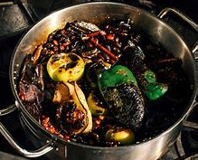
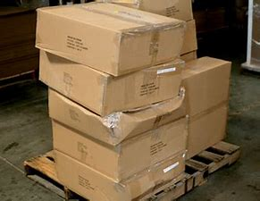
Other Non-Reimbursable Foods
Food items that will be reflected as non-reimbursable due to the following examples:
Damaged
Theft
Burned
Document burned and damaged items on the Damaged Or Discarded Product Log.

Slide 18
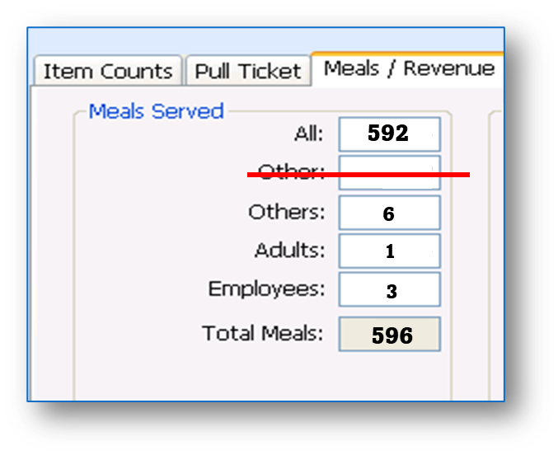
Production Worksheet Entries
Non-Reimbursable/A la Carte numbers are recorded on the Production Worksheet, in “Non-Reimbursable/A La Carte” (column 9) and on the CMS “Meals/Revenue” tab in the “Others” field.
Dropped
Burnt
Theft
1 serving of Burrito was burnt during cooking
1 whole apples were dropped during student service
1+1=
2
2

Slide 19
Required Documents
Several documents are used as a balance point to create a record for all sales transactions.
Adult employee meals
Faculty A La Carte Sales and Inventory Form
Production Worksheet
CMS Production Record
CMS POS “Employee-no ID”
Sales and Cash Reconciliation Form
Non-reimbursable meals
Student A La Carte Sales and Inventory Form
Production Worksheet

Slide 20
Questions?

